Slide 1

Machine Learning Based Automated Construction Planning System for Sri Lanka
24-25J-201

Slide 2
This is our Team
Supervisor - Mr. Supunya Swarnakantha
Co- Supervisor - Dr. Dharshana Kasthurirathna
STUDENT NAME | REGISTRATION NUMBER
Sathurjan . K | IT21188718
Linganathan. J | IT21223808
Silva A A I | IT21188718
R A AHAMED | IT21223808

Slide 3


Introduction
Automated construction is a user-friendly website for users . It uses machine learning to analyze neck circumference cost estimation, material recommends, solar panel specifications Interior Design ,
Simple interface for accessibility to all users
The system aims to automate key planning tasks, enhance decision-making accuracy, and improve project efficiency

Slide 4

Research Question
Accurate, real-time cost and material estimates, considering local market variations and project specifics?
Recommend suitable materials using building plans and weather data, and what are the impacts on durability
What techniques can recommend optimal solar panel specifications and pricing based on energy consumption, location, and technology?
Learning tools improve communication between clients and architects, ensuring requirements are effectively incorporated into designs?

Slide 5




Objectives
Main Objective :
Specific Objectives
To develop architectural design process “Automated architectural plans”, developing a machine learning (ML) based system for automatic architecture planning
To integrate data processing techniques to accurately interpret complex architectural and climatic information
To ensure a user-friendly interface for widespread accessibility.
To Maintain high performance and quick response times

Slide 6
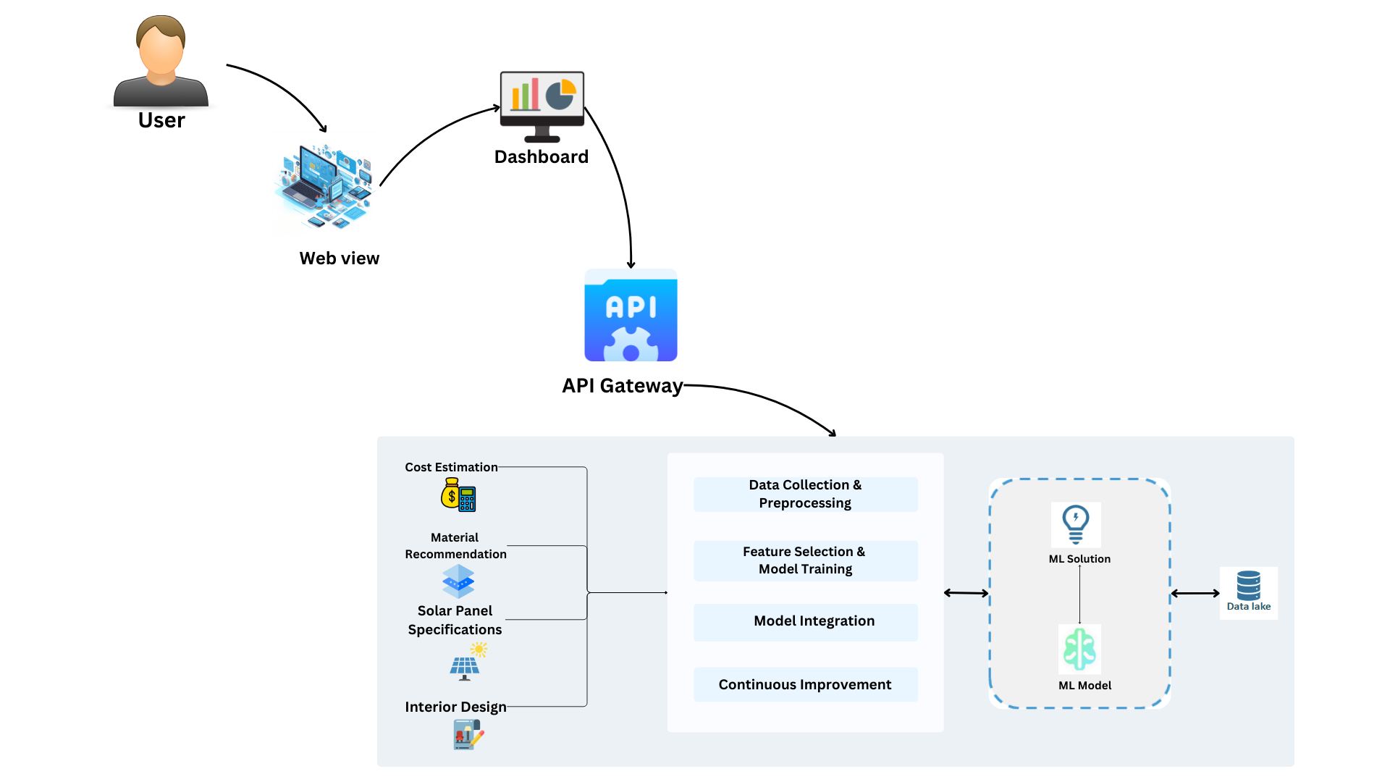
Overall System Diagram

Slide 7

IT21188718 | Sathurjan.K
BSc (Hons) in Information Technology Specializing in IT
IT21188718 | SATHURJAN.K| 24-25J-201

Slide 8
Introduction
Overview:
The real estate market faces challenges in accurately predicting land and house prices due to fluctuating market trends, diverse property features, and varying location-specific factors.
Project Aim:
Develop a machine learning-based system to predict land and house prices, tailored to Colombo's unique real estate market. The system will analyze factors such as property location, size, amenities, and neighborhood characteristics to provide accurate pricing insights.

Slide 9

Research problem
Accurately predicting land and house prices is essential in real estate, particularly given the dynamic market conditions and the unique characteristics of each property. However, challenges such as analyzing vast datasets on location, property size, amenities, and market trends, balancing affordability with accurate predictions, and adapting to local real estate regulations make this task complex.
IT21223808 | LINGANATHAN . J | 24-25J-201

Slide 10

Objectives
Main Objective
Specific Objectives
Implement evaluation methods to assess property features, market trends, and location-specific factors for accurate price predictions.
Integrate data processing techniques to analyze complex datasets, including property details and market dynamics.
Maintain high performance and quick response times, even with large datasets and complex prediction models.
Facilitate efficient decision-making and financial planning for property buyers, sellers, and investors.
Provide accurate land and house price predictions by analysing property details, market trends and location specific factors

Slide 11
Research Gap
Aspect | Details
Accuracy in Price Predictions | Limited availability of tools providing highly accurate land and house price predictions tailored to Colombo.
Integration of Local Factors | Lack of systems that effectively integrate localized data such as neighborhood characteristics and market trends.
Real-Time Market Analysis | Insufficient utilization of real-time market data to adapt predictions to dynamic property trends.
Scalability | Existing models struggle to scale effectively for different locations or property types.

Slide 12
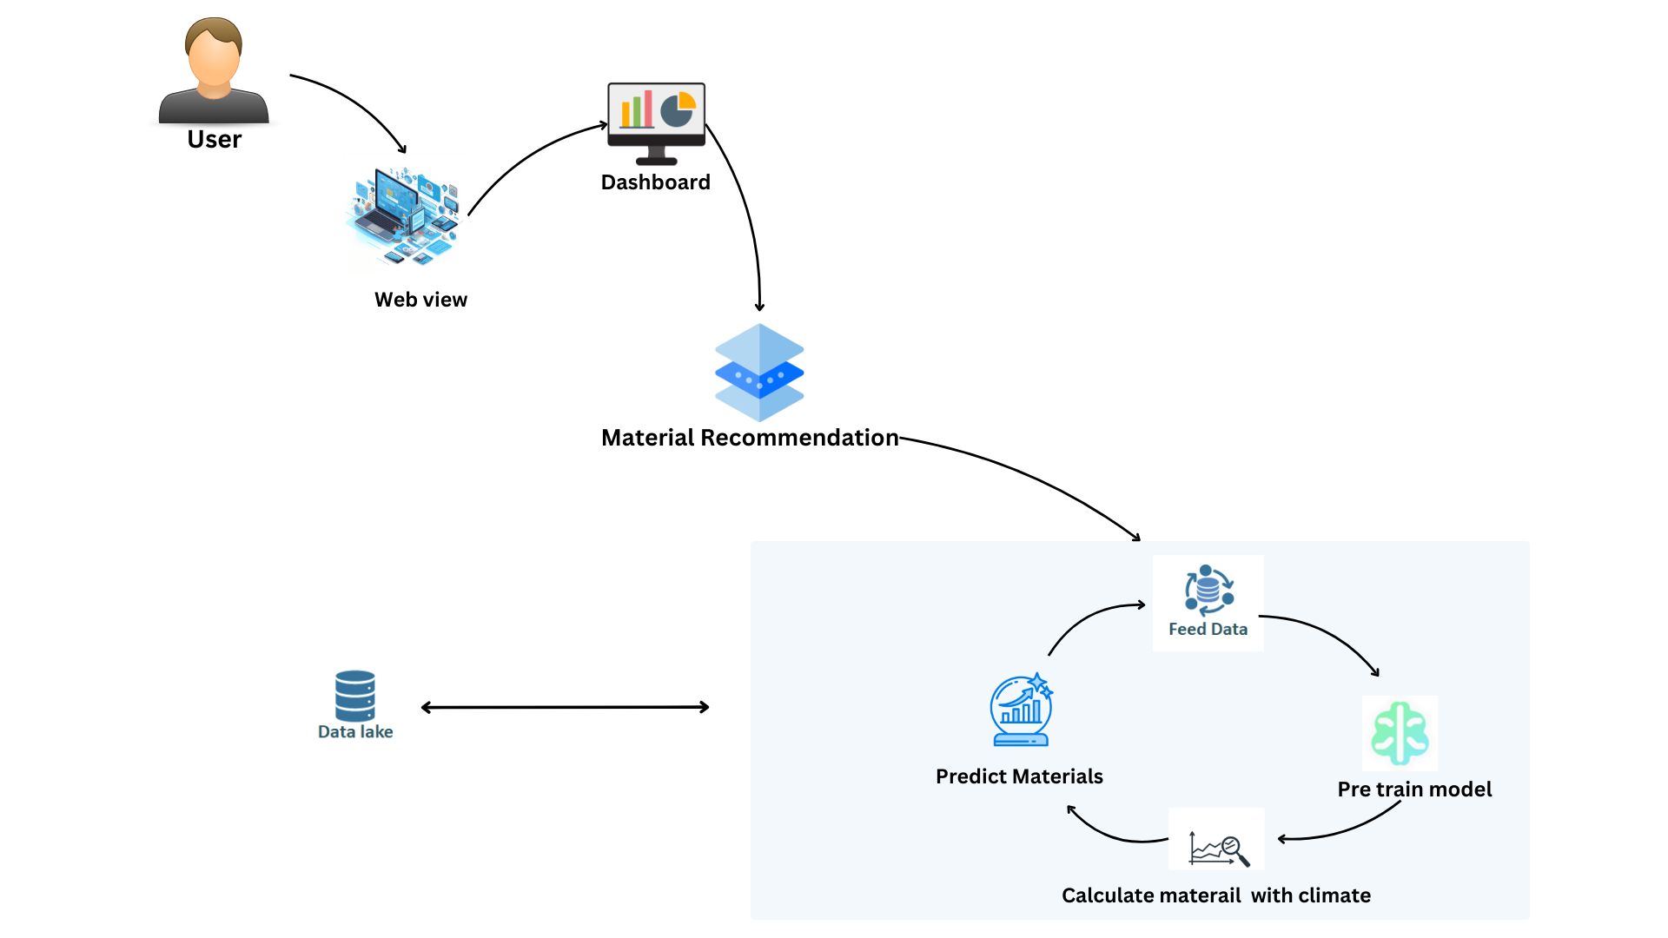
Component Diagram

Slide 13


Technologies
Machine Learning
Python, React, MongoDB (moongose)
Technologies
and
Algorithms
Algorithms
Feature Extraction Techniques
Decision Trees
Random Forests
Linger Regression

Slide 14

The system, Personnel and Software specification requirements
Software Specification Requirement
Non-Functional Requirements
Scalability: Capable of efficiently handling large datasets, complex property details, and increasing user queries without compromising performance or accuracy.
Functional Requirements
User-Friendly Data Input Interface: Enables users to easily input property details, such as land size, location, amenities, and market data.
Price Prediction Dashboard: Displays predicted land or house prices based on detailed analyses, including location and market trends.
Property and Market Data Processing: Utilizes algorithms to interpret complex datasets, including geographic, economic, and neighborhood-specific information.
Required Data Set
Online Dataset
Government website
IT21223808 | LINGANATHAN . J| 24-25J-201

Slide 15
COMPLETION AND REMAINING WORKS
Completion of the Components
Data collection & pre-processing
Train the model
Evaluate the model
Remaining Implementations
Deploy to the cloud and integrate all four components together.
Frontend

Slide 16
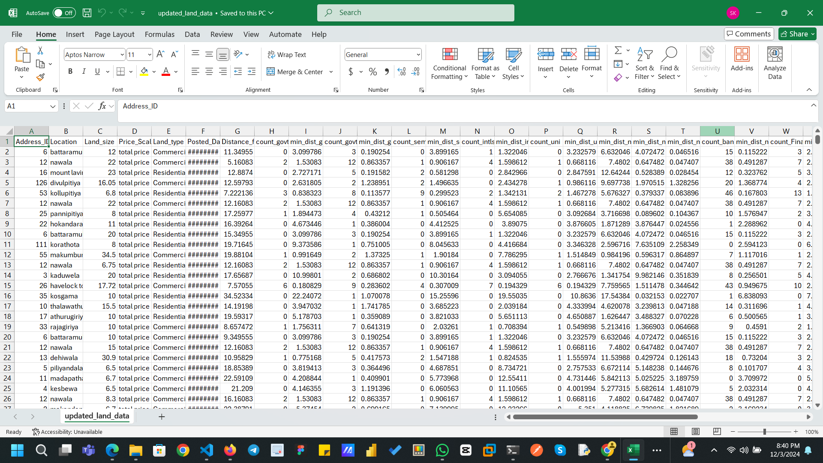
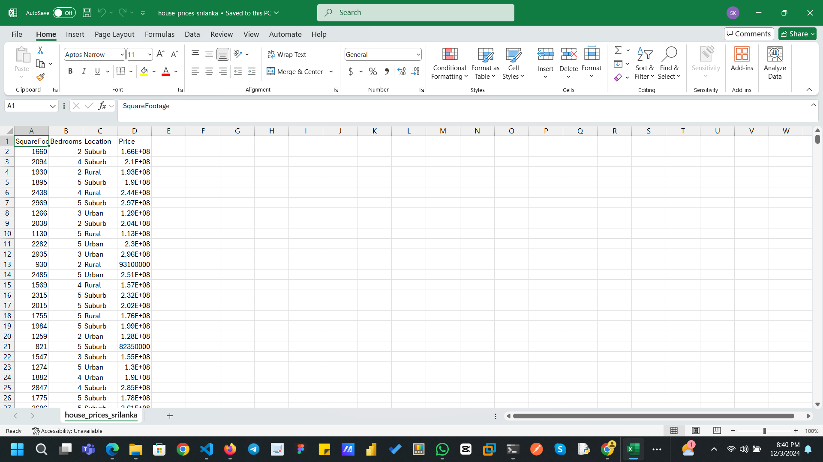
Data Collection

Slide 17
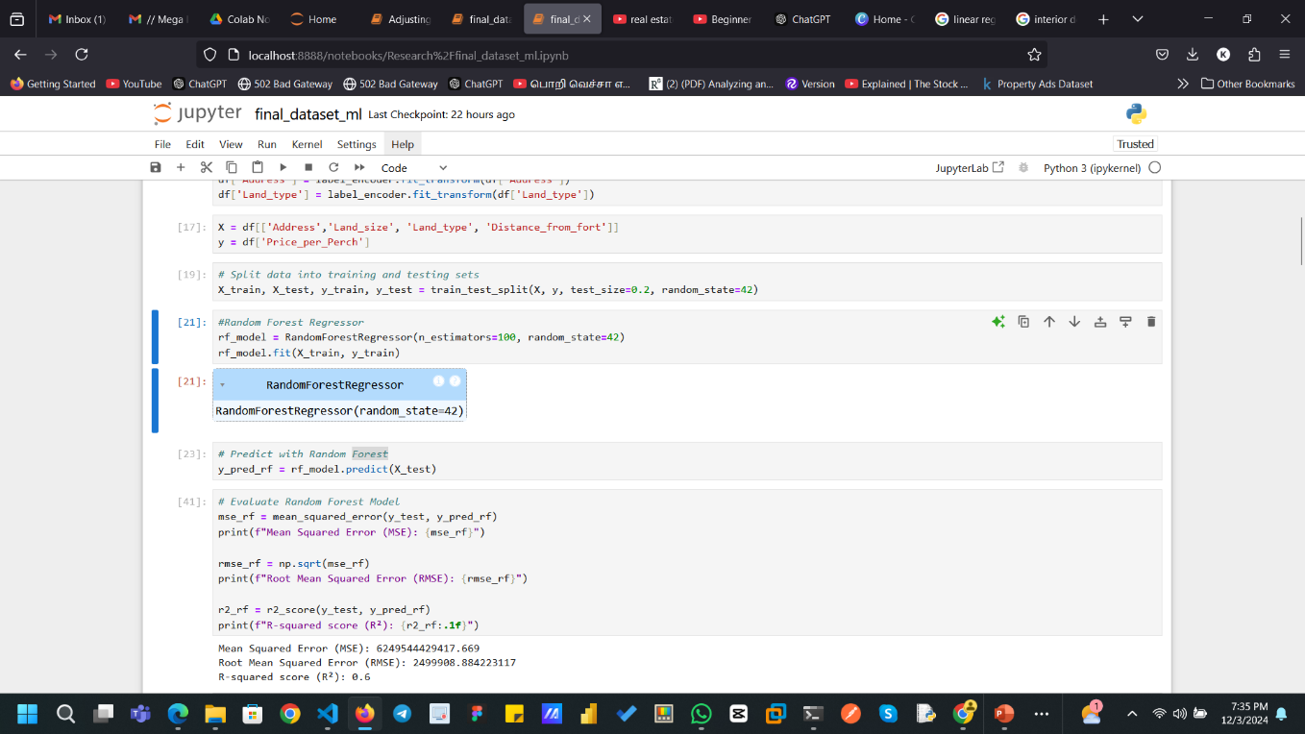
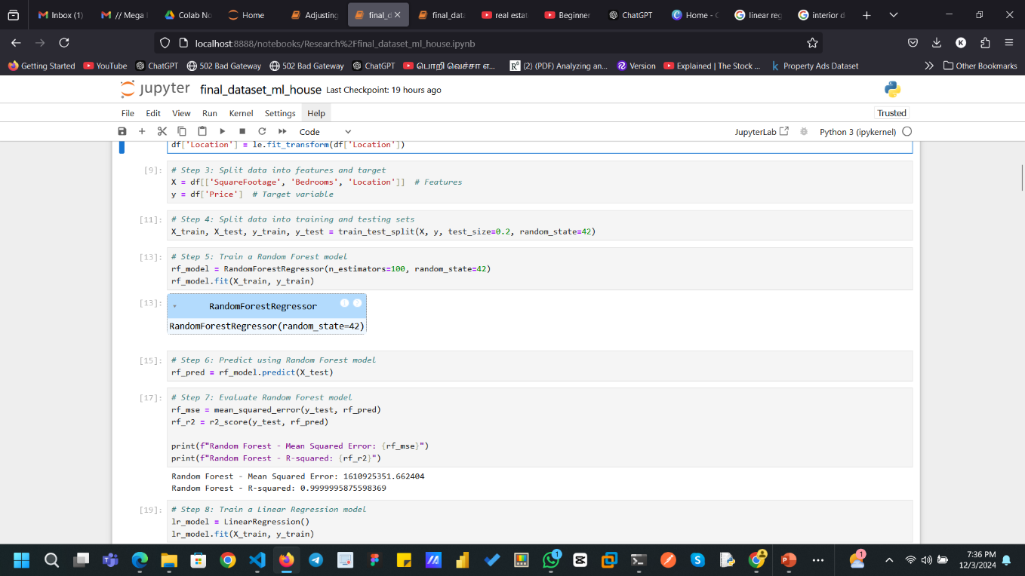

Slide 18
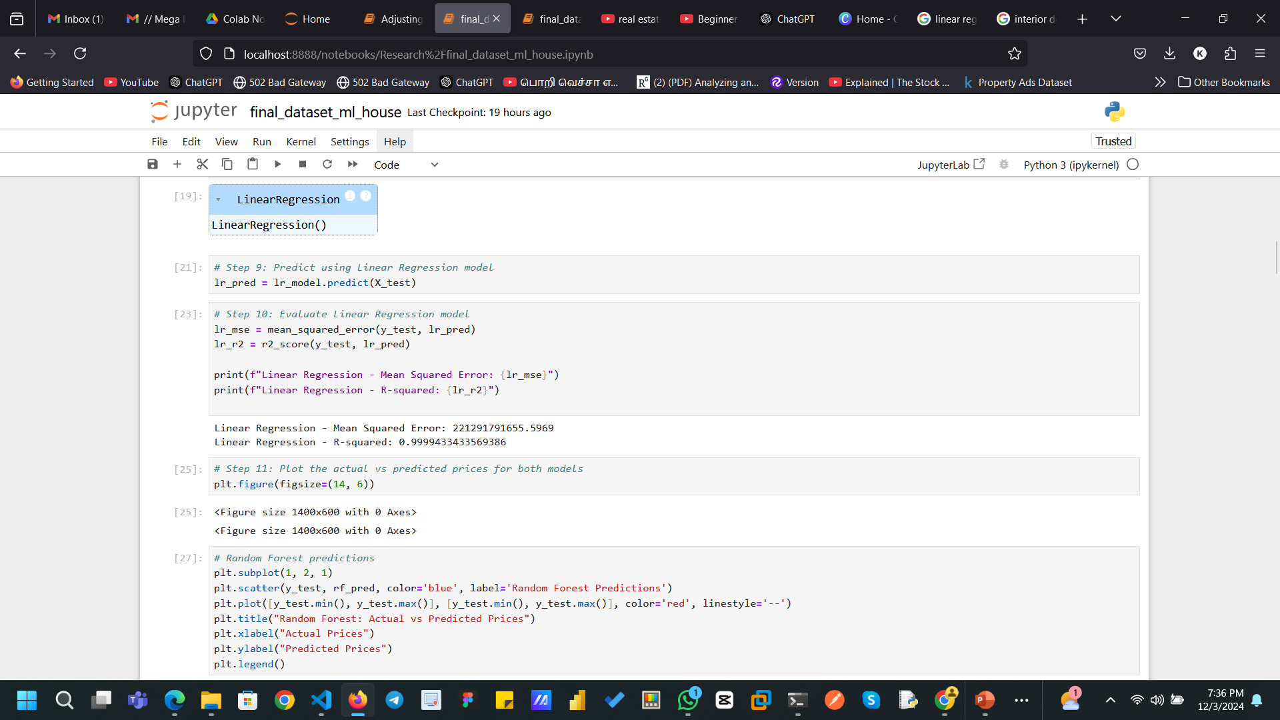
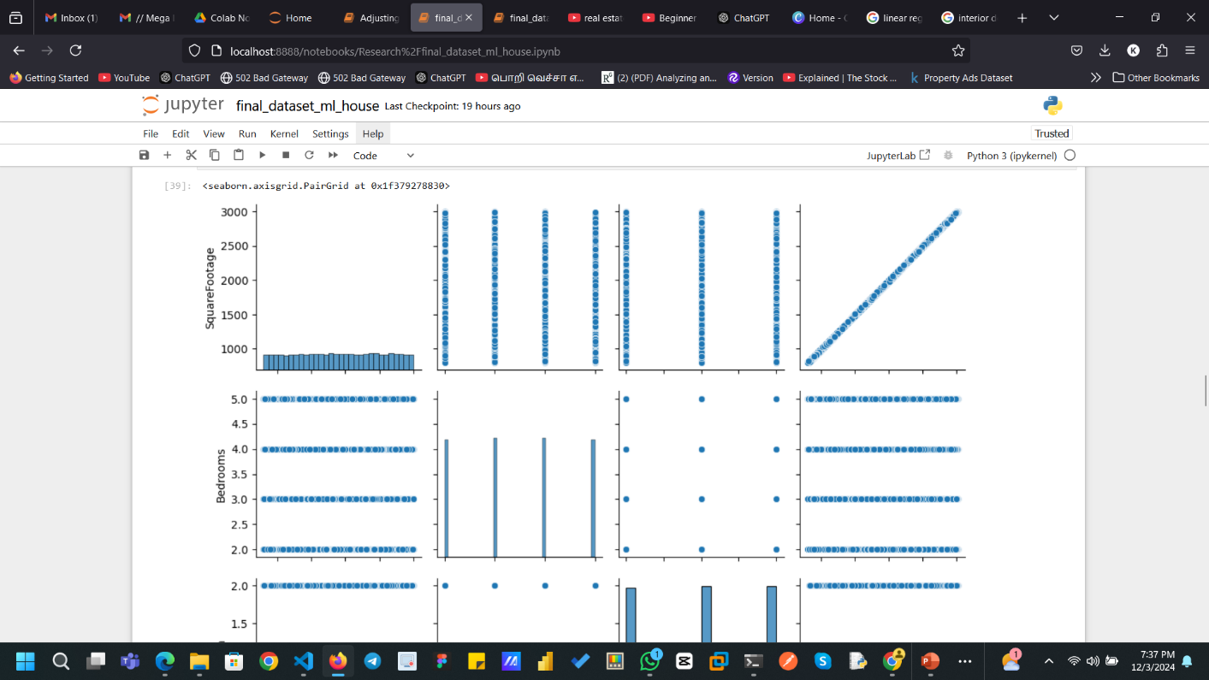

Slide 19
Commercialization
Market Potential :The system offers precise and data-driven land and house price predictions, aligning with the growing demand for real estate analytics tools among developers, investors, and homebuyers.
Business Model :Subscription-based model for individual users such as real estate developers, investors, agents, and homeowners, providing access to price prediction insights and market analysis tools.
Commercialization Strategy :Conduct market analysis to identify target clients, including real estate agencies, property developers, investors, and government regulatory bodies.
Scaling : Introduce new features such as integration with real estate management tools, expansion to other regions, and the inclusion of additional factors like environmental sustainability in price predictions.

Slide 20
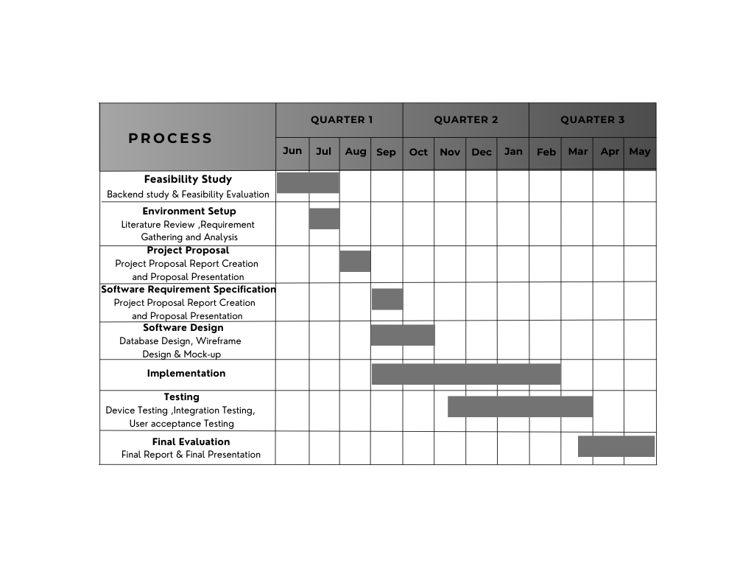
Gantt Chart

Slide 21
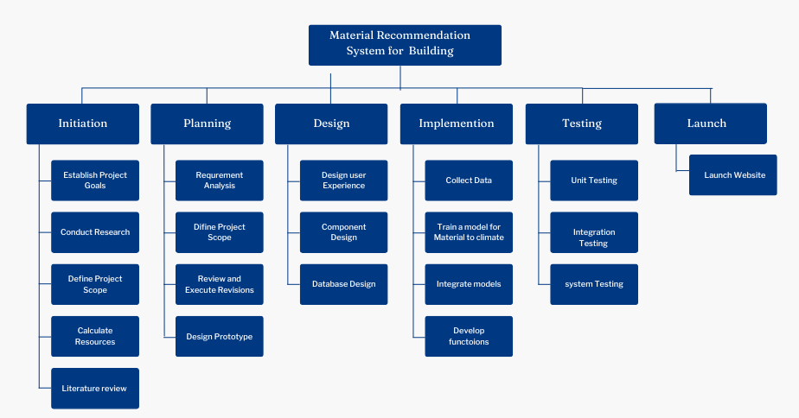
Work Breakdown Structure
Land and house prediction system

Slide 22
References
[1] “The easiest way to find the and compare building materials”, Available: https://2050-materials.com/.
[2]“Building Materials”, Available: https://www.bimobject.com/en/categories/building-materials.
[3] “Building Materials and Components statistics” : https://www.data.gov.uk/dataset/75ee36ed-21f7-4d7b-9e7c-f5bf4546145d/building-materials-and-components-statistics.
[3] “Climate change ” : https://www.data.gov.uk/dataset/75ee36ed-21f7-4d7b-9e7c-f5bf4546145d/building-materials-and-components-statistics.
[4]Kaggle : “Climate change Earth Surface Temperature Data” : https://www.kaggle.com/datasets/berkeleyearth/climate-change-earth-surface-temperature-data?select=GlobalLandTemperaturesByMajorCity.csv

Slide 23

IT21223808 |Linganathan.J
BSc (Hons) in Information Technology Specializing in IT
IT21223808 | LINGANATHAN . J | 24-25J-201

Slide 24
Introduction
Overview:
- Solar energy is a key solution to the growing energy needs and environmental concerns
- Harnessing solar power efficiently can significantly reduce carbon footprint and energy costs.
Project Aim:
- Develop a system to recommend optimal solar panel specifications and pricing.
- Base recommendations on estimated energy consumption and available land area.
IT21223808 | LINGANATHAN . J| 24-25J-201

Slide 25
Research problem
The growing demand for renewable energy necessitates cost-effective solar panel installations. However, challenges like predicting energy consumption, selecting suitable configurations, and balancing cost, efficiency, and space constraints remain.
The research aims to recommend solar panel specifications and pricing based on estimated energy consumption and available land area. It explores models, algorithms, selection methods, and cost estimation methods to develop a tailored system for reliable solar panel recommendations.
IT21223808 | LINGANATHAN . J | 24-25J-201

Slide 26
Objectives
Main Objective :
Specific Objectives
Ensure scalability and accuracy of the system.
Provide secure and private data handling.
Maintain high performance and quick response times.
Create algorithms to calculate land area and estimate power demand.
Develop a user-friendly interface for data collection.
Integrate cost consumption estimation using Linear Regression and Clustering Algorithms.

Slide 27
Research Gap
The existing research literature lacks accurate and personalized solar panel installation recommendations.
Current methods often fail to integrate energy consumption predictions with customized configurations and cost estimations.
This gap highlights the need for a more comprehensive approach.
The proposed research aims to fill this gap by developing a system using advanced algorithms to predict energy consumption, optimize solar panel configurations, and integrate cost estimation methods.
This will provide precise, efficient, and cost-effective solar panel recommendations, enhancing the adoption and effectiveness of solar energy solutions.
IT21223808 | LINGANATHAN . J| 24-25J-201

Slide 28
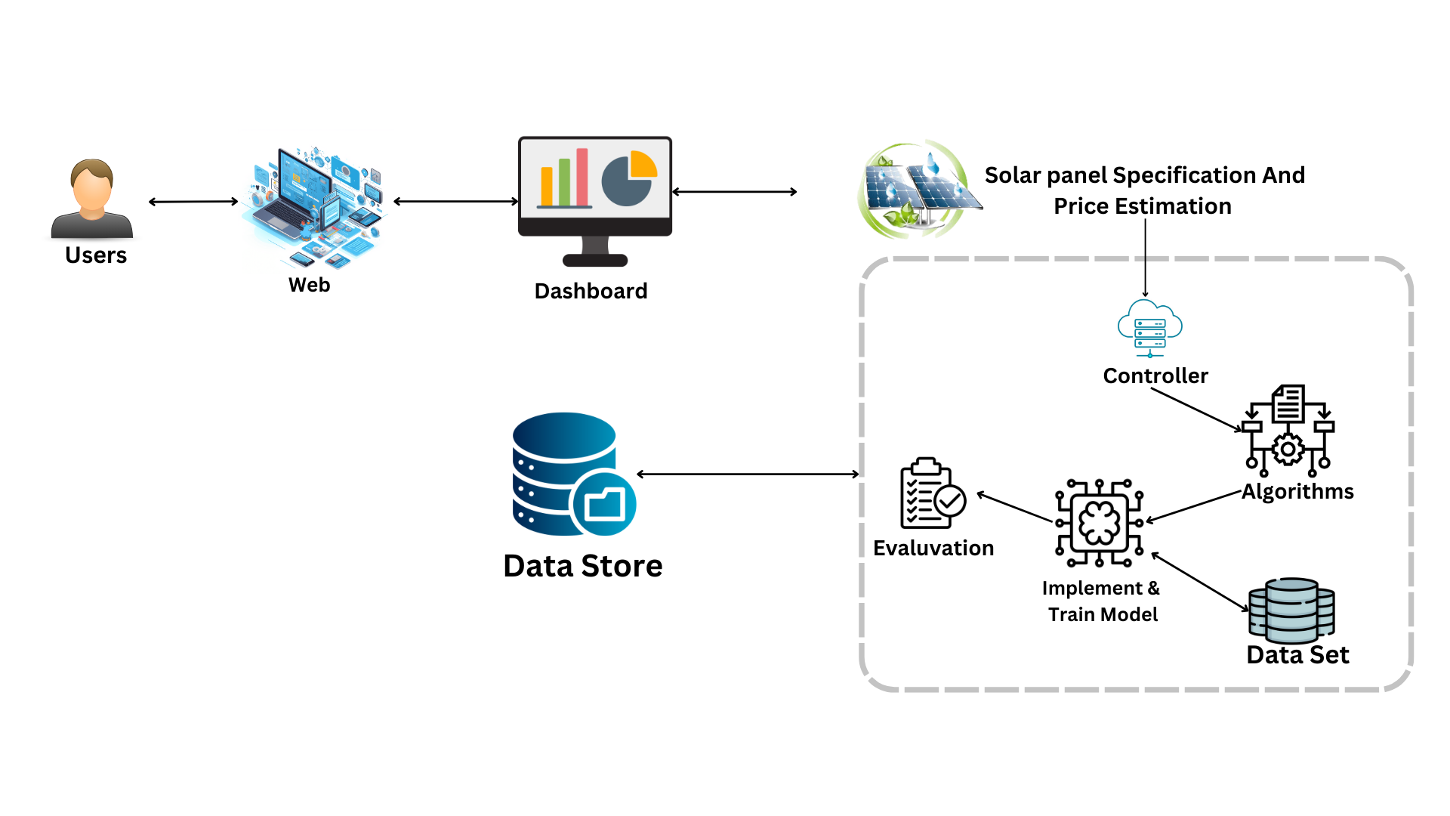
Component Diagram
IT21223808 | LINGANATHAN . J| 24-25J-201

Slide 29
Technologies
Machine learning
Python, React , MongoDB (moongose)
Technologies
and
Algorithms
Algorithms
Linear Regression : Predict number of panels, price, or efficiency
Clustering Algorithms : Group panels based on price and efficiency
Random Forest Regressor : Predict efficiency and panel size.
IT21223808 | LINGANATHAN . J | 24-25J-201

Slide 30
The system, Personnel and Software specification requirements
Software Specification Requirement
Non-Functional Requirements
Scalability - Handle large datasets and numerous user requests.
Security - Protect user data and ensure privacy.
Functional Requirements
User-friendly data input interface.
Dashboard for solar panel recommendations, energy consumption, and cost analysis.
Historical energy consumption data processing.
Machine learning models for predicting future energy consumption.
Algorithms for handling various data types and formats.
Linear Regression and Clustering Algorithms for cost and savings estimation.
Required Data Set
Solar company
CEB (Ceylon Electricity Board)
IT21223808 | LINGANATHAN . J| 24-25J-201

Slide 31
COMPLETION AND REMAINING WORKS
Completion of the Components
Data collection & pre-processing
Train the model
Evaluate the model
Connect Backend with Flask API
Completed check input validation
Completed check data flows
Connect and store MongoDB
Remaining Implementations
Deploy to the cloud and integrate all four components together.
Frontend

Slide 32
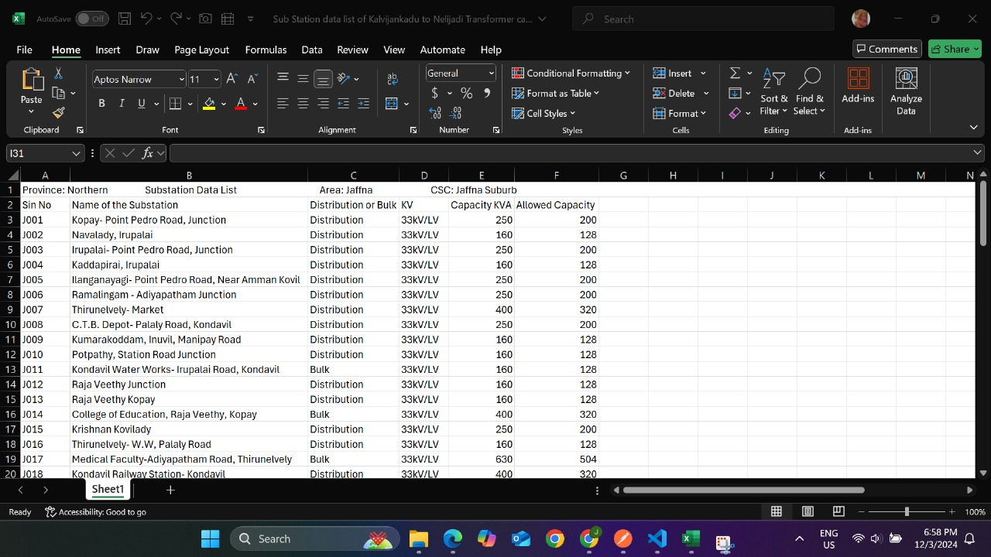
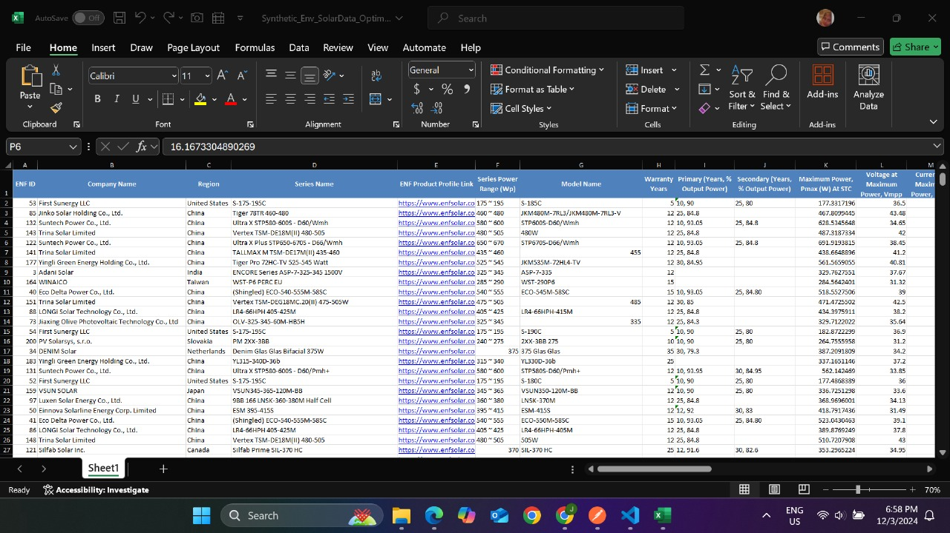
Data Collection

Slide 33
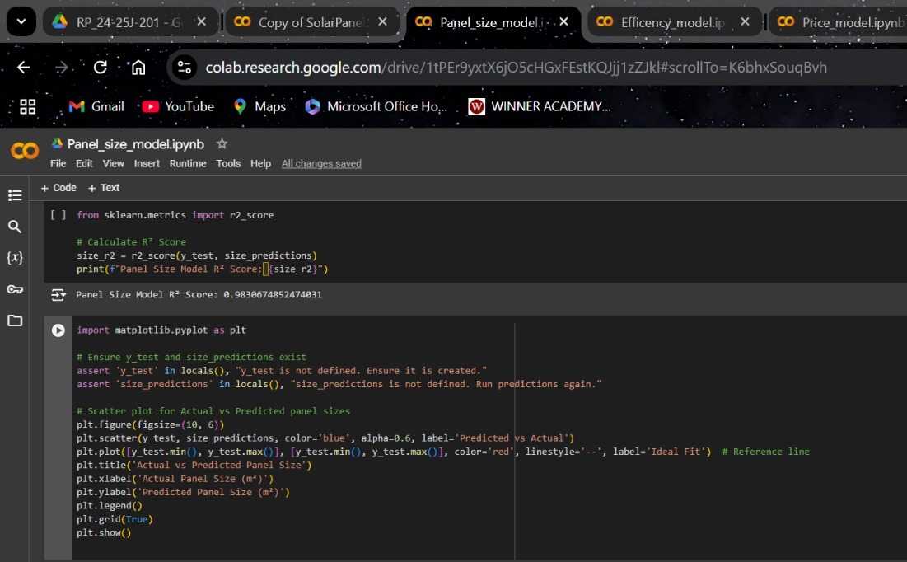
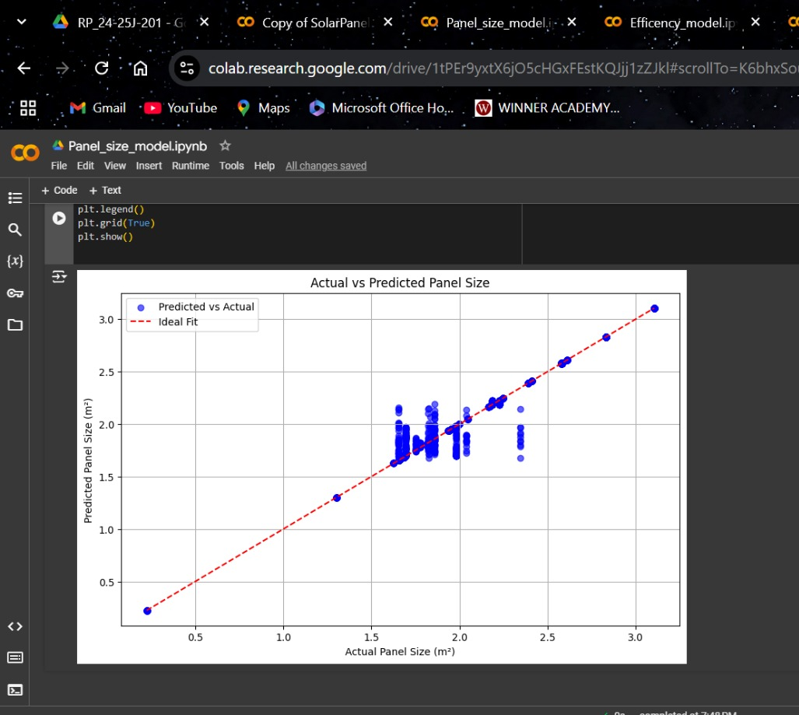

Slide 34
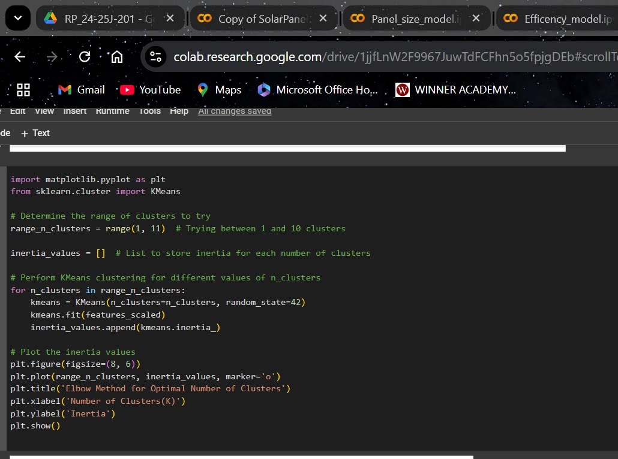
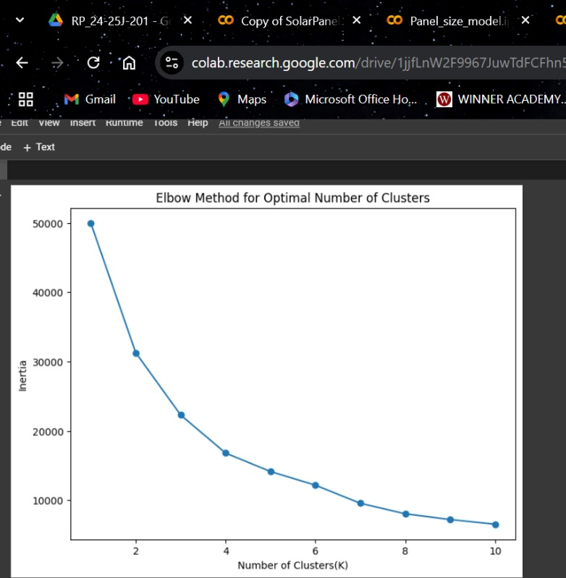

Slide 35
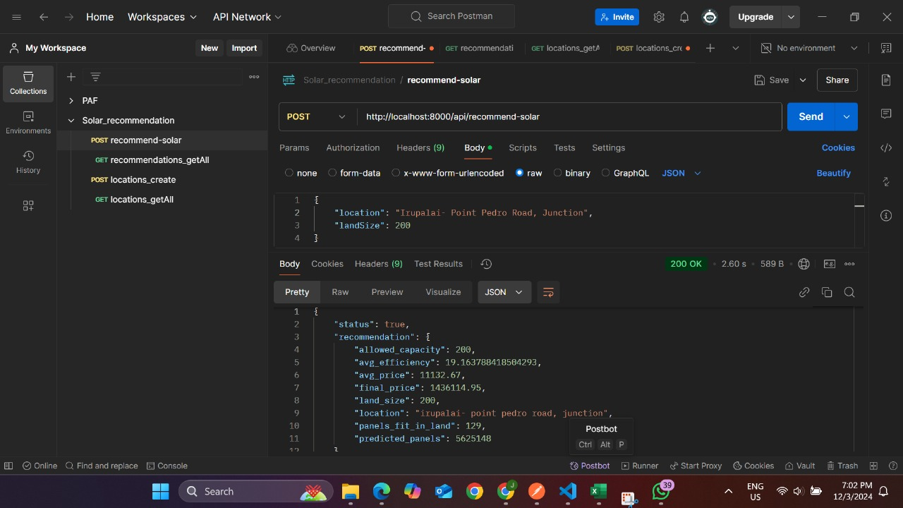
Postman check data flow

Slide 36
Commercialization
Market Potential : High demand for renewable energy creates a strong opportunity. The system offers precise, affordable solar recommendations
Business Model : A subscription-based model for end-users and a licensing model for businesses, with tiered plans based on service levels
Commercialization Strategy : Market analysis to identify target clients, pricing, and partners and product refinement on improve based on pilot feedback
Scaling : Scale the system with new features and expand to international markets as the user base grows.

Slide 37
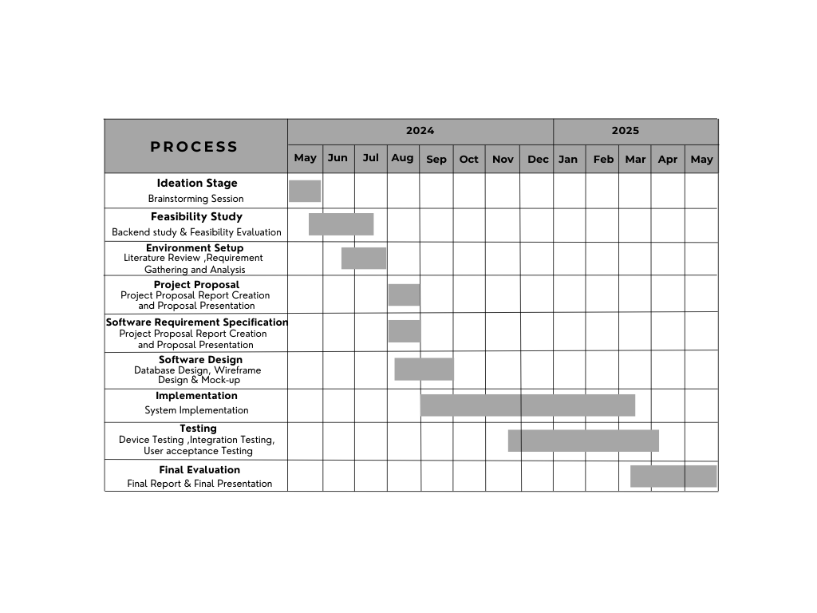
Gantt Chart
IT21223808 | LINGANATHAN . J| 24-25J-201

Slide 38
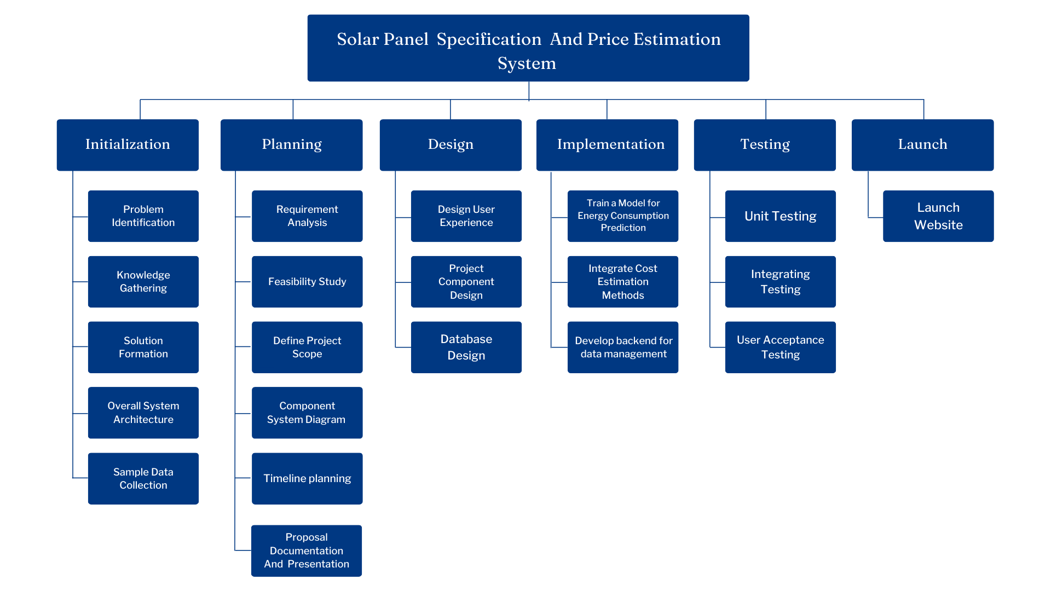
Work Breakdown
Structure

Slide 39
References
[1] Ani Kannal, “Solar Power Generation Data: Solar power generation and sensor data for two power plants”, Feb,2020, Available: https://www.kaggle.com/datasets/anikannal/solar-power-generation-data/data.
[2] Meshva , “Solar energy power generation dataset: Solar power generated from a solar plant”, May,2021, Available: https://www.kaggle.com/datasets/stucom/solar-energy-power-generation-dataset .
[3] UK Power Networks , “Photovoltaic (PV) Solar Panel Energy Generation data: UK Power Networks”, April,2022, Available: https://data.london.gov.uk/dataset/photovoltaic--pv--solar-panel-energy-generation-data .
[4] Yingchen Zhang (Manager, Sensing, Measurement, and Forecasting Group), “Solar Power Data for Integration Studies(NREL's Solar Power Data for Integration Studies are synthetic solar photovoltaic (PV) power plant data points for the United States representing the year 2006,” Jun. 2023, Available: https://www.nrel.gov/grid/solar-power-data.html .
[5] Sheffield Solar , “PV_Live:Live PV generation,” 03 August. 2024, Available: https://www.solar.sheffield.ac.uk/pvlive/ .
[6] Nate Blair, Nicholas DiOrio, Janine Freeman,Paul Gilman, Steven Janzou, Ty Neises, and Michael Wagne, “System Advisor Model (SAM)
General Description,” national laboratory of the U.S. Department of Energy Office of Energy Efficiency & Renewable Energy Operated by the Alliance for Sustainable Energy, LLC, vol. 2017.9.5, TP-6A20-70414, May. 2020, doi: http://www.osti.gov/scitech .
IT21223808 | LINGANATHAN . J| 24-25J-201

Slide 40

IT21188718 |R A Ahamed
BSc (Hons) in Information Technology Specializing in IT
IT21158018 | R A AHAMED | 24-25J-201

Slide 41
Introduction
Overview:
Construction projects often have trouble estimating costs because material prices change and project needs are different.
Accurate and flexible estimation methods can greatly help with budgeting and planning for projects.
Project Aim:
Develop a system that uses machine learning to provide real-time construction cost and material estimations.
Use current market data and past trends to make sure the estimates are accurate and can adjust to changes.

Slide 42
Research Problem
The construction industry still uses old methods for cost estimation, which often leads to mistakes and overspending. This project aims to use machine learning to improve cost predictions by adjusting them based on real-time data, fixing these problems.

Slide 43
Objectives
Objectives
Specific Objectives
Create a strong machine learning model that can predict construction costs and material needs accurately and adjust as needed.
Improve the model's ability to adjust to new data and make more accurate estimates as time goes on.
Create an easy-to-use interface where users can enter project details and get cost and material estimates.
Use past data to improve the model’s ability to make accurate predictions and respond to changes.

Slide 44
Research Gap
Lack of Dynamic Methods: Current research does not offer flexible and adjustable methods for estimating construction costs and materials.
Reliance on Static Data: Existing methods often use fixed data, which doesn't consider real-time changes in material prices and labor costs.
Need for Adaptive Approach: There's a clear need for a more flexible, data-driven approach to overcome these issues.
Proposed Solution: This research proposes developing a system that uses machine learning algorithms to adjust cost estimates dynamically.

Slide 45
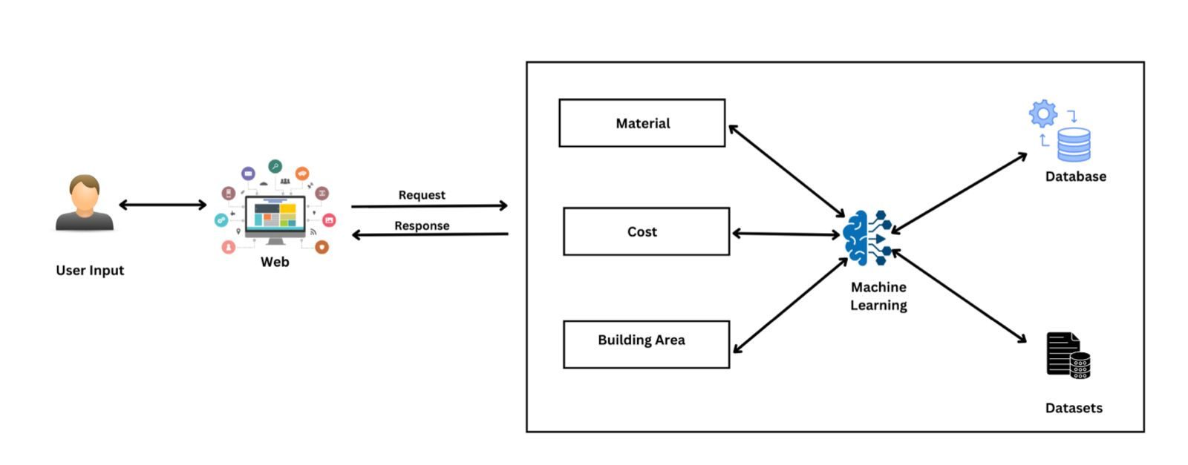
Component Diagram

Slide 46
Technologies
Machine Learning: Enhance predictive accuracy and adaptability.
Python: For backend development and model implementation.
MongoDB: To store and manage dynamic data inputs and outputs.
Technologies
and
Algorithms
Algorithms
Linear Regression: To predict costs based on various inputs.
Clustering Algorithms: To categorize materials and associated costs for better estimation.

Slide 47
The system, Personnel and Software specification requirements
Software Specification Requirement
Functional Requirements
User-Friendly Interface for Data Input: Include forms to enter built-up area and estimated cost per square foot along with other project-specific details.
Dashboard to Display Cost Breakdowns: Show detailed breakdowns of construction costs, material estimations, and potential savings.
Real-Time Data Processing: Ability to handle real-time data for accurate and dynamic cost estimation.
Machine Learning Model Implementation: Utilize regression models and other algorithms to predict and adjust construction costs based on historical data and ongoing market trends.
Non-Functional Requirements
Scalability: The system must efficiently handle large datasets and multiple user queries without performance degradation.
Security: Ensure high levels of security to protect sensitive construction cost data and user inputs.
Required Data Set
Historical Construction Cost Data: Gathered from past projects and standard construction cost databases.
Real-Time Market Data: Use APIs to fetch current material costs and labor rates.
User-Entered Project Details: Forms that capture detailed information about the construction project’s scope and specifications.
IT21223808 | LINGANATHAN . J| 24-25J-201

Slide 48
COMPLETION AND REMAINING WORKS
Completion of the Components
Data collection & pre-processing
Train the model
Evaluate the model
Remaining Implementations
Deploy to the cloud and integrate all four components together.
Frontend

Slide 49
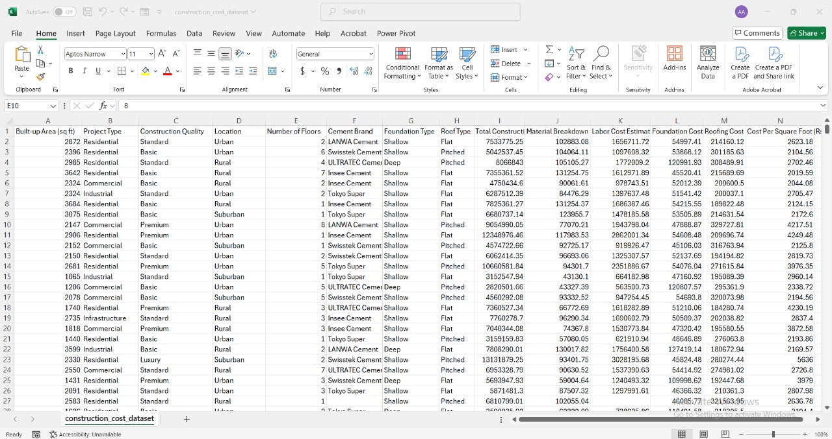
Data Collection

Slide 50
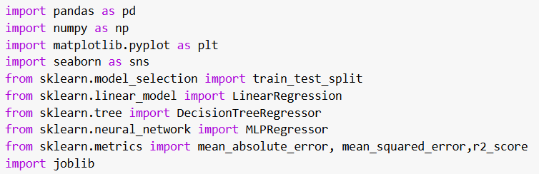
Libraries Used

Slide 51
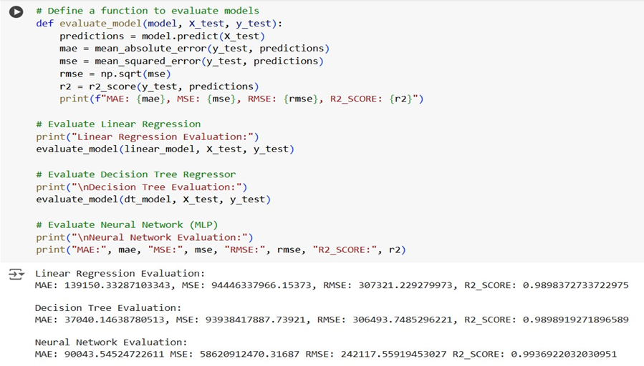
Model Training & Accuracy

Slide 52
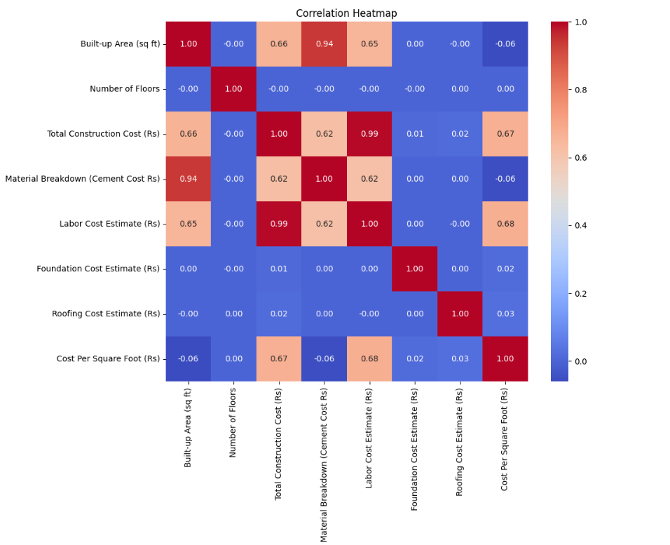
Correlation heatmap
Visualizes relationships between numerical columns.

Slide 53
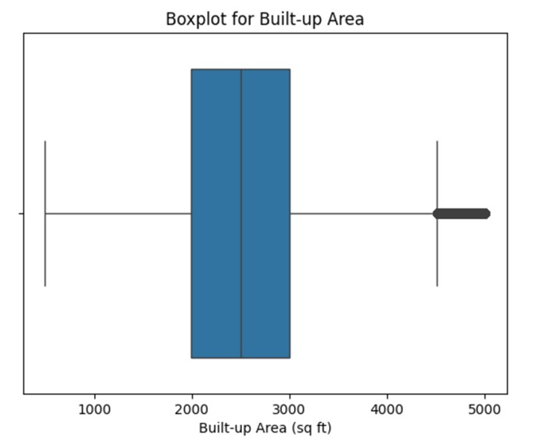
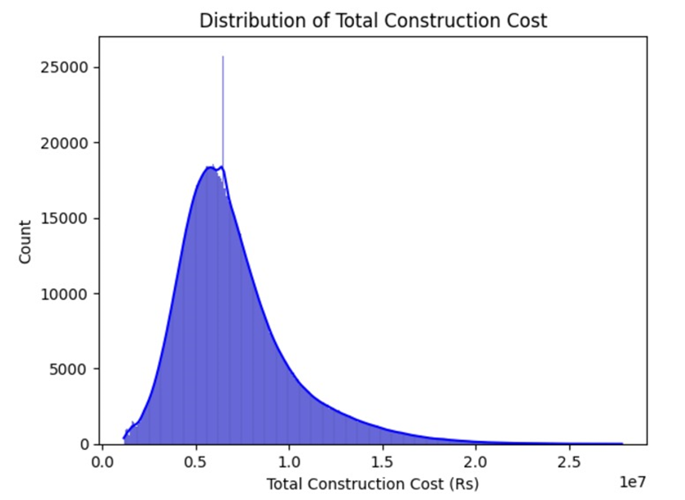
Distribution and boxplots
Understands the spread and outliers of specific columns.

Slide 54
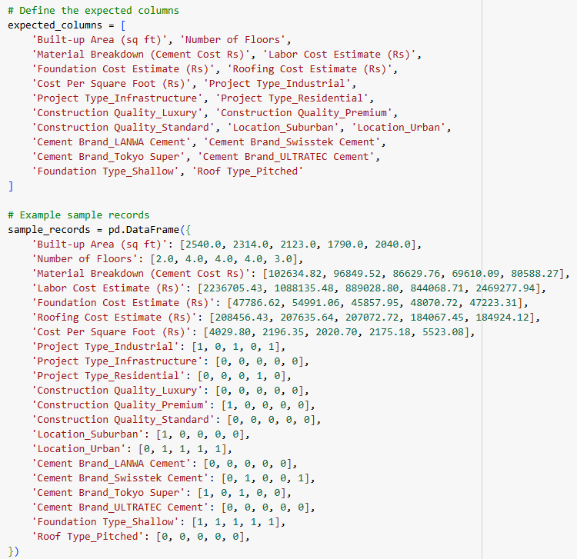
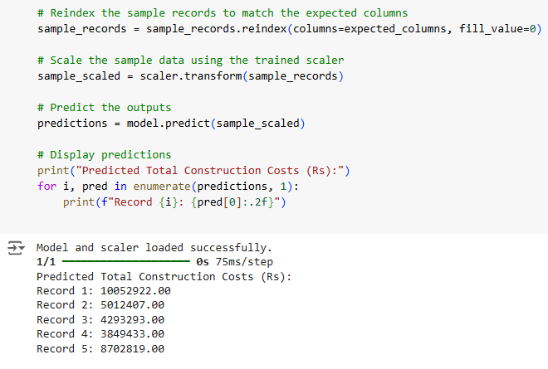
Predict construction costs for new inputs using the neural network.

Slide 55

Market Demand: Identify the need for digital tools in construction.
Target Market: Focus on construction companies, project firms, and government.
Pricing Structure: Offer different pricing plans for various service levels.
System Features: Highlight real-time, accurate cost estimates.
Revenue Models: Generate income through subscriptions, services, and data analysis.
Marketing and Distribution: Create a strategy for wide market reach and long-term growth.

Slide 56
Gantt Chart

Slide 57

Work Breakdown Structure

Slide 58
References
[1] Sphurti S. Arage and Nagaraj V. Dharwadkar, "Cost Estimation of Civil Construction Projects Using Machine Learning Paradigm," IEEE. Available: [https://ieeexplore.ieee.org/document/8058249](https://ieeexplore.ieee.org/document/8058249).
[2] Sanaz Tayefeh Hashemi, Omid Mahdi Ebadati, and Harleen Kaur, "Cost Estimation and Prediction in Construction Projects: A Systematic Review on Machine Learning Techniques," SN Applied Sciences, vol. 2, article 1703, September 2020. Available: [https://link.springer.com/article/10.1007/s42452-020-03497-1](https://link.springer.com/article/10.1007/s42452-020-03497-1).
[3] Salman Saeidlou and Nikdokht Ghadiminia, "A Construction Cost Estimation Framework Using DNN and Validation Unit," Available: [https://www.tandfonline.com/doi/full/10.1080/09613218.2023.2196388](https://www.tandfonline.com/doi/full/10.1080/09613218.2023.2196388).
[4] Suchitha, N. V., Adithya, S., Ashik, S., Dhanush, S., & Thrinsh Reddy S. G. (Year). Home construction cost estimation using ML. Sri Dharmasthala Manjunatheshwara Institute of Technology. Retrieved from https://www.irejournals.com/formatedpaper/1704488.pdf

Slide 59

IT21301254 | Silva A.A.I
BSc (Hons) in Information Technology Specializing in IT
IT21301254 | Silva A.A.I | 24-25J-201

Slide 60
Introduction
Overview:
The Interior Design Collaboration Platform bridges communication gaps between clients and designers. By helping clients express their ideas more clearly, it reduces misunderstandings and inefficiencies, streamlining the design process.
Project Aim:
Develop an interactive design dashboard that integrates text and image inputs, enabling clear, real-time communication between clients and interior designers for better understanding and faster decision-making.
IT21301254 | Silva A.A.I | 24-25J-201

Slide 61
Research problem
Communication Gap- Clients have a clear vision but lack the technical language to communicate effectively with interior designers, leading to misunderstandings, design iterations, and delays.
Inefficiency and Rework- Clients' inability to clearly express design preferences leads to multiple revisions, inefficiencies, higher costs, and reduced productivity, affecting client satisfaction.
IT21301254 | Silva A.A.I | 24-25J-201

Slide 62
Objectives
Main Objective :
Specific Objectives
Utilize AI LLM-powered image generation to visualize client design ideas accurately.
Implement a reinforcement learning-based recommendation system that adapts to client preferences according to reward feedback.
Develop an AI-driven platform to enhance client-designer communication and improve design efficiency.
IT21301254 | Silva A.A.I | 24-25J-201

Slide 63

Research Gap
Existing platforms lack integration of text and image inputs for complete design communication.
Current tools do not use advanced AI LLM-driven image generation for accurate visualizations.
Traditional systems miss out on reinforcement learning algorithms like Q-learning for adapting recommendations.
Current platforms do not use policy-gradient methods for optimizing design suggestions in real-time.
Platforms lack adaptive learning to improve recommendation relevance based on client feedback.
IT21301254 | Silva A.A.I | 24-25J-201

Slide 64
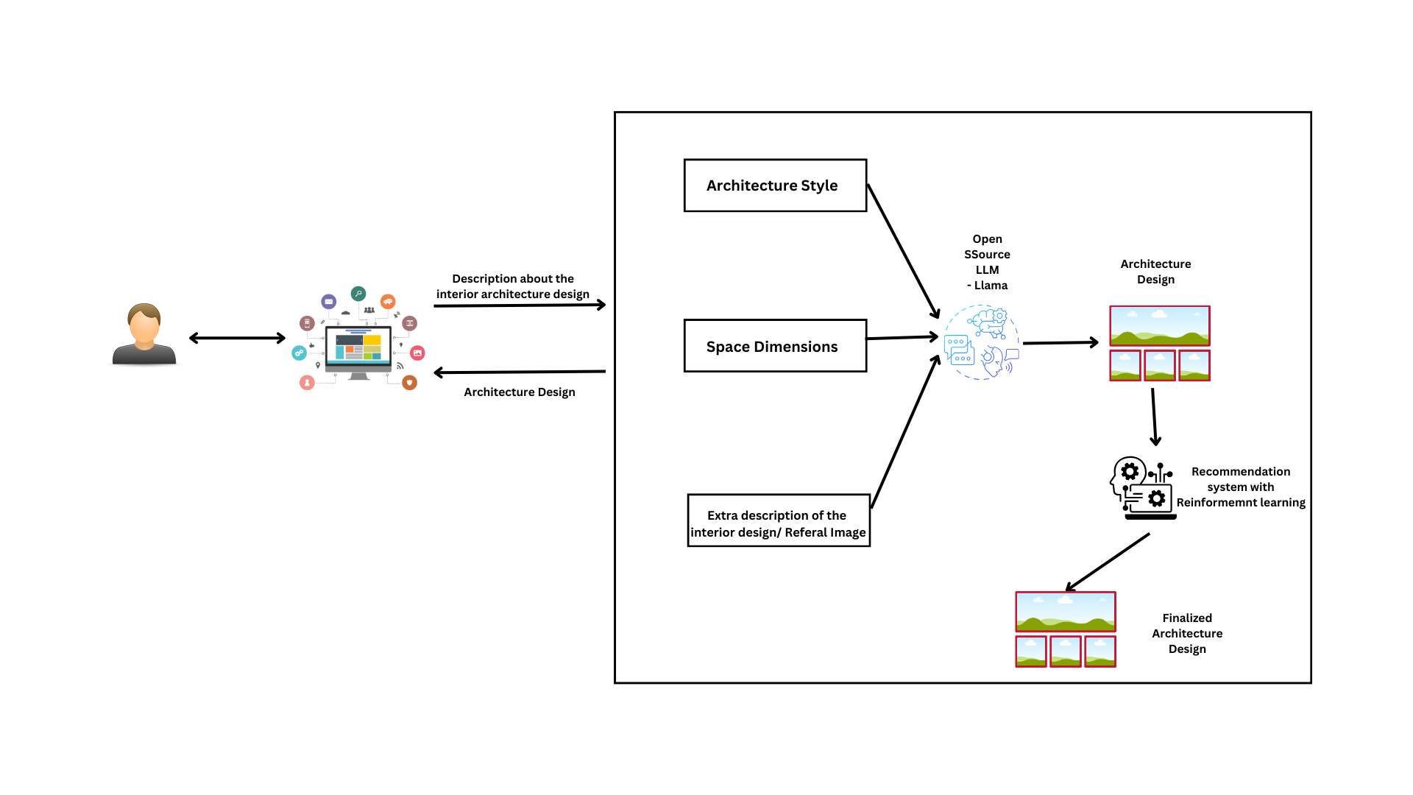
Component Diagram
IT21301254 | Silva A.A.I | 24-25J-201

Slide 65
Technologies Used
Backend: Python
Frontend: React
AI and Machine Learning: Open Source LLM, Reinforcement Learning (Q-learning, Policy Gradient)
Recommendation System: Collaborative Filtering, Matrix Factorization
Database: MongoDB
API: Flask API
Cloud Hosting: Azure
Technologies
and
Algorithms
IT21301254 | Silva A.A.I | 24-25J-201

Slide 66
The system, Personnel and Software specification requirements
Software Specification Requirement
Non-Functional Requirements
Performance: Handle high loads with minimal latency.
Usability: Intuitive interface for seamless interaction.
Reliability: Consistent availability and minimal downtime.
Accuracy: Ensure precise design visualizations and recommendations.
Functional Requirements
Image generation for design visualization.
Personalized design recommendations using reinforcement learning.
Integrated text and image input for design feedback.
Real-time updates on design adjustments and feedback.
Required Data Set
Kaggle Datasets: Publicly available design data and trends.[1]
Sri Lankan Interior Architecture: Region-specific data from local designers.
IT21301254 | Silva A.A.I | 24-25J-201

Slide 67
COMPLETION AND REMAINING WORKS
Completion of the Components
Data collection & pre-processing
Train the model
Evaluate the model
Remaining Implementations
Deploy to the cloud and integrate all four components together.
Frontend

Slide 68
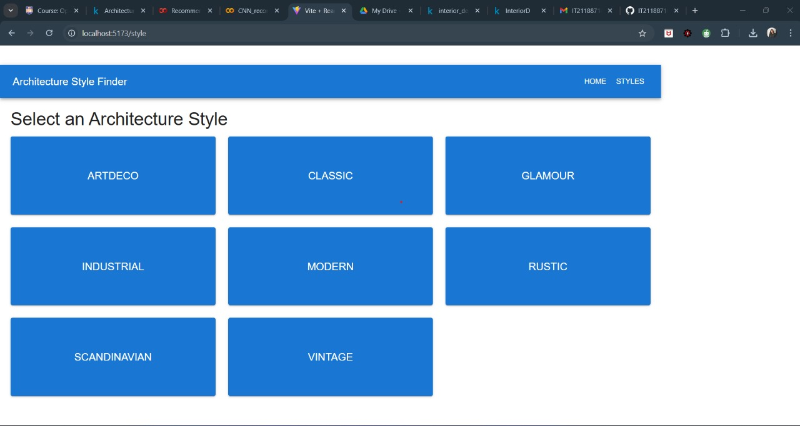
Project Evidences
Frontend Development

Slide 69

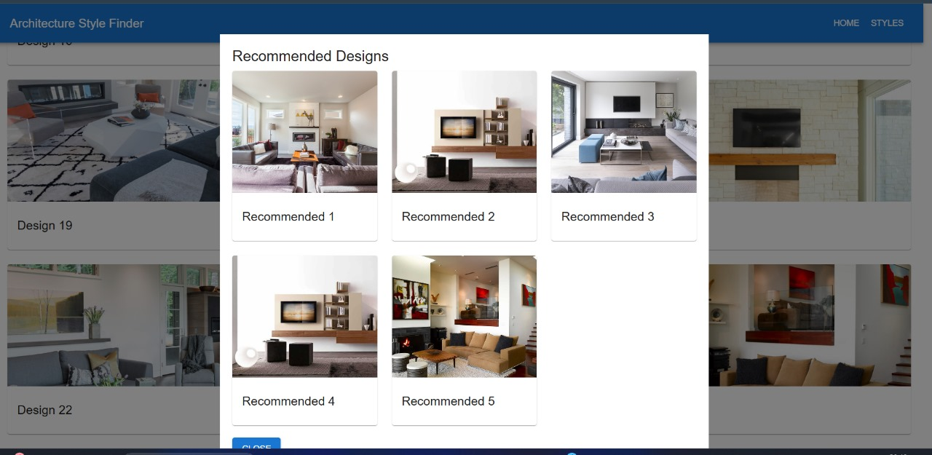

Slide 70
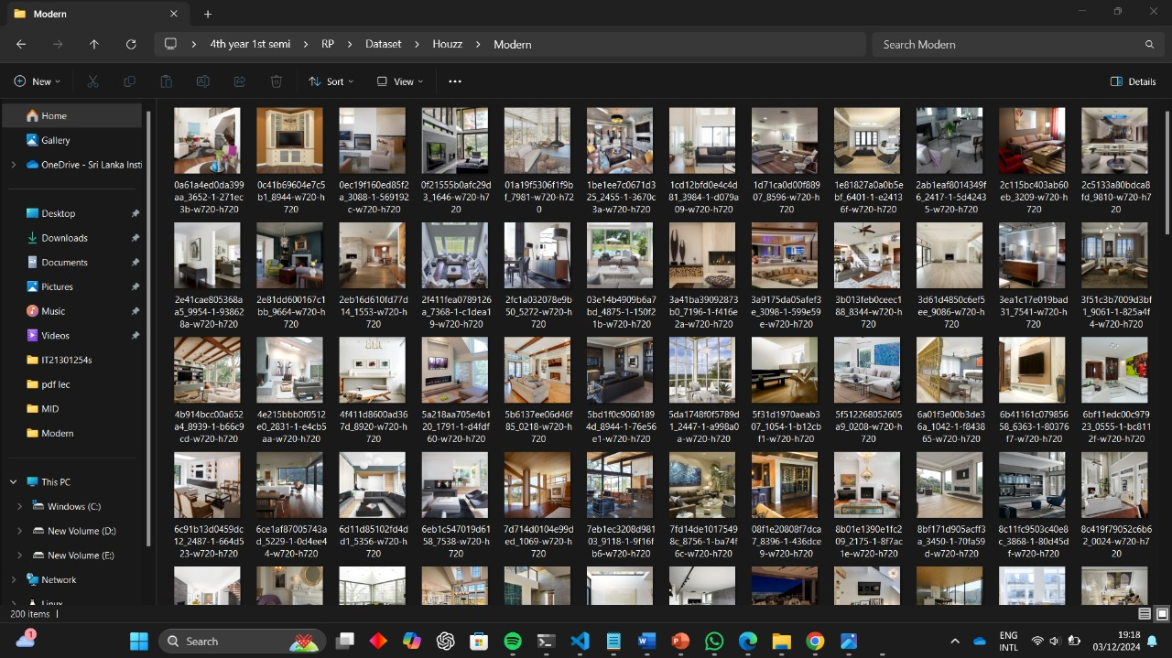

Slide 71
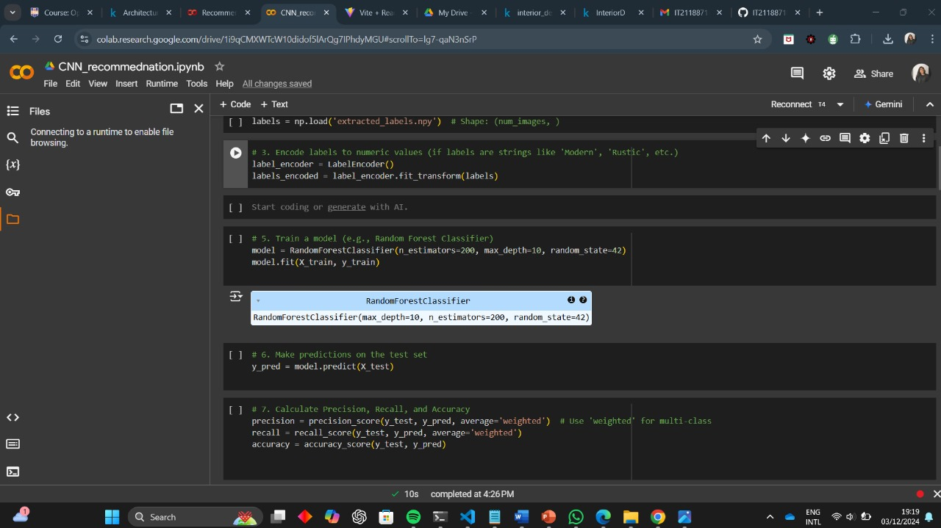
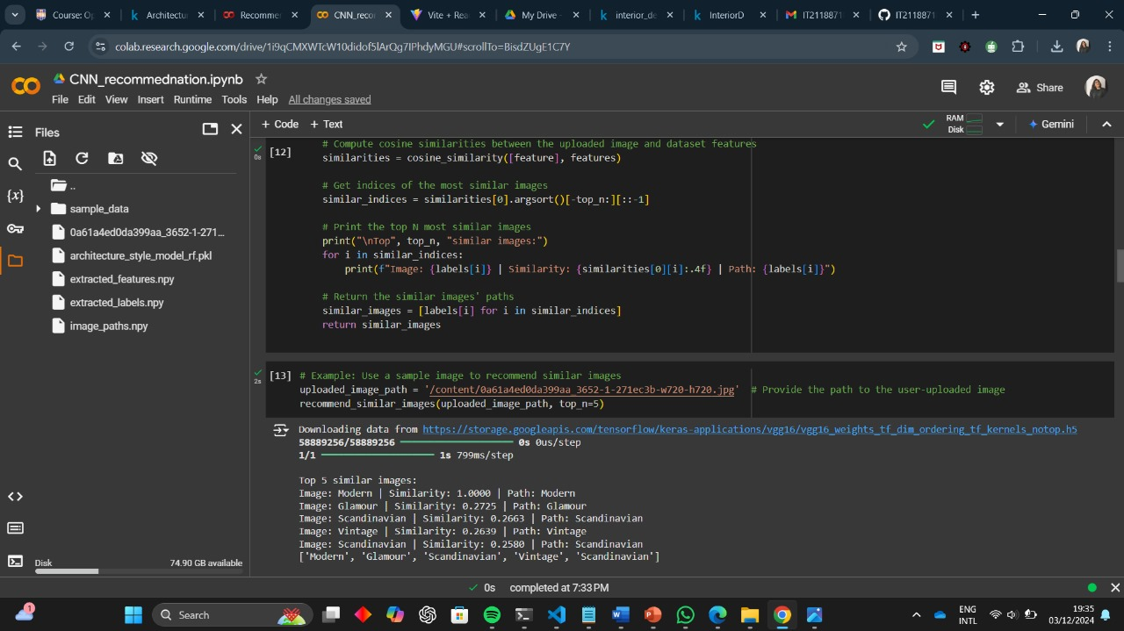

Slide 72
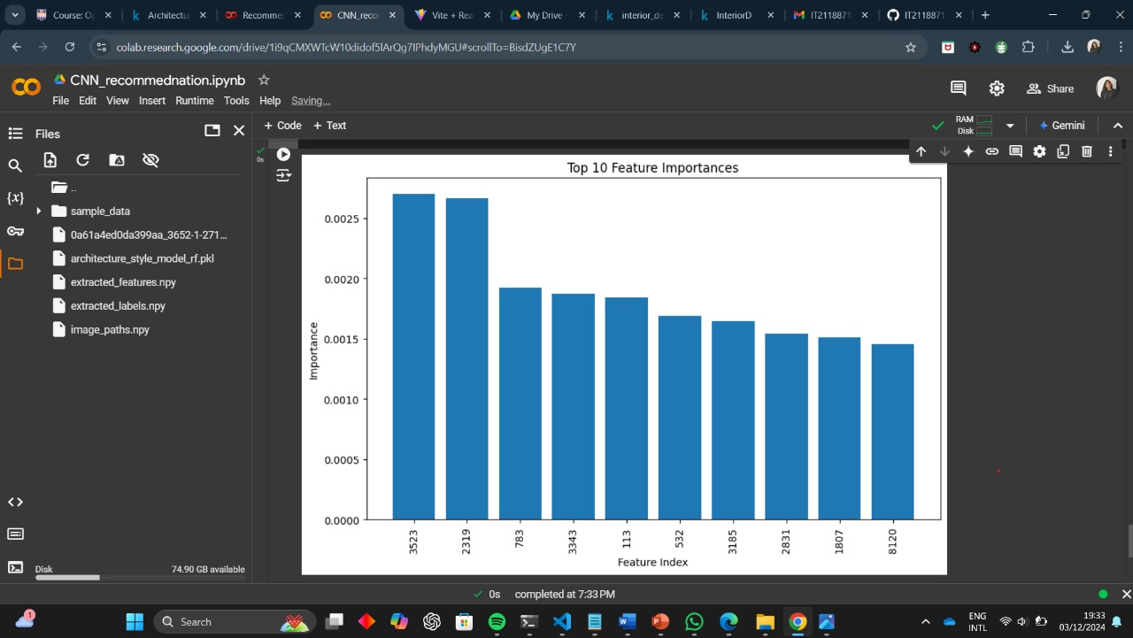

Slide 73
Marketing and Sales Strategy: Leverage digital marketing, partnerships, and local events to drive adoption.
Market Analysis: Target interior designers, architects, and developers; capitalize on growing demand and limited AI competition.
Pricing Strategy: Offer subscription tiers, pay-per-use, and educational discounts.
IT21301254 | Silva A.A.I | 24-25J-201

Slide 74
Gantt Chart
IT21301254 | Silva A.A.I | 24-25J-201

Slide 75

Work Breakdown Structure
IT21301254 | Silva A.A.I | 24-25J-201

Slide 76
References
[1] DUMITRUX, "Architectural Styles," Available: [https://www.kaggle.com/datasets/dumitrux/architectural-styles-dataset]
[2] Zhe Xu, Ya Zhang, Dacheng Tao, and Junjie Wu, "Architectural Style Classification Using Multinomial Latent Logistic Regression," Shanghai Jiao Tong University, Sun Yat-Sen University, 2014. Available: [https://www.researchgate.net/publication/275604099_Architectural_Style_Classification_Using_Multinomial_Latent_Logistic_Regression]
[3] Nima Norouzi, Maryam Shabak, Mohamed Rashid Embi, and Tareef Hayat Khan, "The Architect, the Client and Effective Communication in Architectural Design Practice," Universiti Teknologi Malaysia, Islamic Azad University, January 2015. Available: [https://www.researchgate.net/publication/273501174_The_Architect_the_Client_and_Effective_Communication_in_Architectural_Design_Practice]
[4] Feiyang Pan, Qingpeng Cai, Pingzhong Tang, Fuzhen Zhuang, and Qing He, "Policy Gradients for Contextual Recommendations." Available: [https://arxiv.org/abs/1802.04162](https://arxiv.org/abs/1802.04162).
IT21301254 | Silva A.A.I | 24-25J-201

